Slide 1
Ideal Workplace
Student Name
Institution Affiliation

Slide 2

Workplace Hierarchies
Dominance Hierarchies involve workplace type of social hierarchy
Dominance hierarchy helps;
Reduce conflict in the workplace
Ensure balance in workplace
Fair description of the marginalized group
Balance in authority

Slide 3
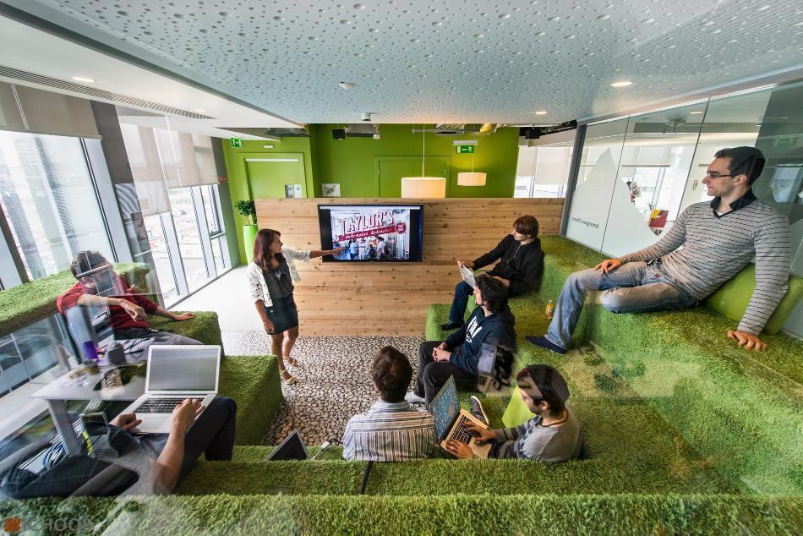
Workplace Culture
Character and overall personality of an organization
Definition of history and course of workplace cultivated better culture
Workplace culture is portrayed through;
Organization traditions
Organization beliefs
Behavioral attitudes
Interaction between organization employees

Slide 4
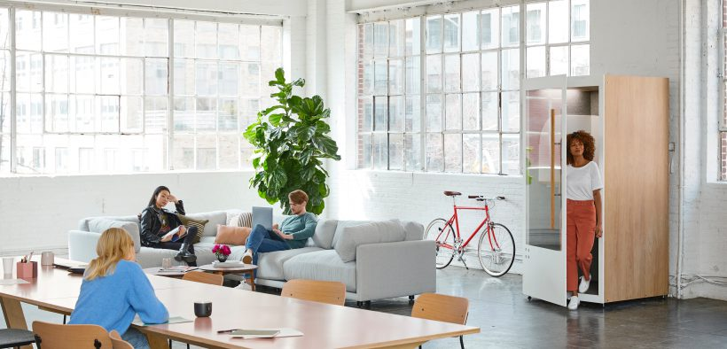
Distance Travel Between Work and Home
Road transport and footy commuting are used to travel from home to work
Essential aspects when travelling from home to work include;
Time in relation to distance covered
Harsh climate conditions
Technology innovations

Slide 5

Required Job Skills and Training
Society moral and technical support
Workers Idea sharing
Partnership with government for better employees training

Slide 6

Technology
Technology facilitates smooth running of organizational activities
Technology has reduced labor intensive tasks
Technology has increased unemployment

Slide 7

Workplace and Gender
The concept of multidirectional
Precise gender balance improvement over the years
Equal presentation of opportunities to both genders
Employees evaluation in form of merits

Slide 8
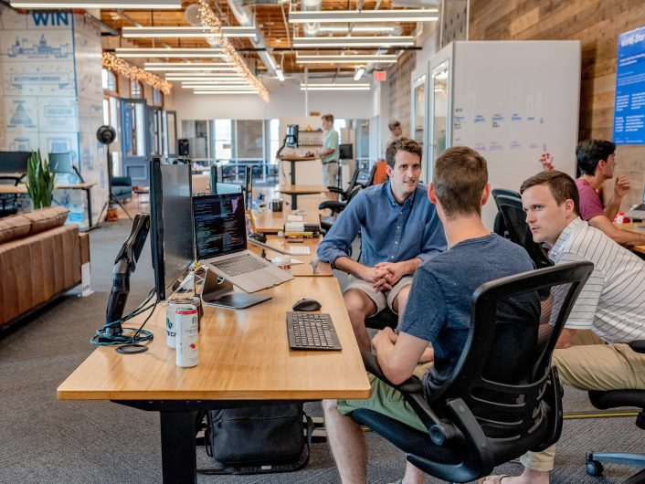
Issues of Inequality
Age and gender inequality within organizations
Inequality related to discrimination
Inequality extend to wage distribution
Moral upright top management helps reduce inequality

Slide 9

Employee Job Security
Employees should not be given exclusive rights that guarantee job security
Non-committed workers needs coaching
Workers sometimes lack knowledge
Employee mentoring process is important

Slide 10

Globalization
Slave trade led to globalization
Technology has reduced the world to a small village
Globalization has led to increased wages

Slide 11

Work/Life Balance
Performing assigned work accordingly improves employee work/life balance
Employee trust is essential in work/life balance
Qualification of employee defined their capability
Employer-employee harmony in workplace is essential

Slide 12
References
Beck, U. (2018). What is globalization? John Wiley & Sons.
Findlay, P., Warhurst, C., Keep, E., & Lloyd, C. (2017). Opportunity knocks? The possibilities and levers for improving job quality. Work and Occupations, 44(1), 3-22.
Knudsen, M. L. (2018). What's in a Wage: Minimum Wage Increases and Workplace Hierarchies in the Restaurant Industry (Doctoral dissertation, Northwestern University).
Stoet, G., & Geary, D. C. (2018). The gender-equality paradox in science, technology, engineering, and mathematics education. Psychological science, 29(4), 581-593.
Weaver, P., Jansen, L., Van Grootveld, G., Van Spiegel, E., & Vergragt, P. (2017). Sustainable technology development. Routledge.

